Slide 1
Menopause
MB.ChB V. DR. OTARA

Slide 2
Menopause
Learning objectives
At the end of the lesson you should be able to;
Define climacteric, pre-menopause, menopause and postmenopause
Classify menopause
Describe physiological changes that are associated with the menopause
Describe the various stages of menopause and their management
Describe the indications of hormonal replacement therapy
State complications of menopause and their management
MB.ChB V. DR. OTARA

Slide 3
Definitions
Natural menopause is the permanent cessation of menstrual periods, determined retrospectively after a woman has experienced 1yr of amenorrhea without any other obvious pathological or physiological cause.
Median age of 51.4 yrs in normal women
Reflects complete, or near complete, ovarian follicular depletion, with resulting hypoestrogenemia and high follicle-stimulating hormone (FSH) concentrations
MB.ChB V. DR. OTARA

Slide 4
Definitions
Premature menopause/ovarian failure/ primary ovarian insufficiency.
Menopause <40 yrs is considered to be abnormal
  Surgical removal of ovaries
  Ovarian ablation; radiation, chemotherapy
  Autoimmune
  Anaemia, malnutrition
  Idiopathic
MB.ChB V. DR. OTARA

Slide 5
Definitions
Late reproductive years
40 yrs
Hormonal changes
Menstrual cycles are ovulatory, but the follicular phase begins to shorten (14-10/7)
MB.ChB V. DR. OTARA

Slide 6
Definitions
Perimenopause:
The climacteric( Gr. Kilimakter, a ladder) is a phase of the aging process which a woman passes from the reproductive to the non-reproductive stage.
Menopausal transition/premenopause: occurs after the reproductive years, but before menopause
Begins on average 4 yrs before the final menstrual period (FMP), average 47 years
Characterized by
  lengthening in the intermenstrual interval ,
  endocrine changes,
  symptoms such as hot flashes.
MB.ChB V. DR. OTARA

Slide 7
Definitions
Post menopause
Post-menopause is the phase of life that comes after menopause
From the final menstrual period and lasts the rest of her life
Signs of menopause taper off over 1-2 years
Increased risk of medical conditions related to low estrogen
MB.ChB V. DR. OTARA

Slide 8
Definitions
Stages of Reproductive Aging Workshop (STRAW) staging system
Menopausal transition: early and late stages
Perimenopause,
Final menstrual period (FMP),
Post-menopause : early and late stages.
Significance: fertility potential, contraceptive needs,need for hormone therapy.
MB.ChB V. DR. OTARA

Slide 9
Physiology
Menopause is thought to be as a result of failure of ovulation/ loss of ovarian follicular function
  In utero 6/12- maximum primordial follicles 2million
  Gradual decline upto menopause, 2 process involved in the apoptosis
    Normal atresia (majority)
    Ovulation- about 400-500 times in awomans lifetime
MB.ChB V. DR. OTARA

Slide 10
Physiology
Reduced no. of primordial
follicles respond to
FSH/LH
Reduced no. of
Graafian follicles
Show mature change
X5 increase in
Circulating FSH/LH levels
Fall in circulating
Estrogen level
Increased hypothalamic
Release of
GnRH
MB.ChB V. DR. OTARA

Slide 11
Endocrine changes in menopause
  Hypothalmo-pituitary-ovarian axis
  Gradual depletion of functional ovarian follicles
  Decline in estrogen production; Granulosa cells gradually lose ability for estradiol production. principally estrone produced by aromatization of androstenedione in adipose tissues
  Luteal phase progesterone levels decrease as fertility potential begins to decline
  Declining inhibin B levels from granulose cells
  Decrease in anti-müllerian hormone (AMH), a product of the granulosa cell
  Decline in androgen production
  Increased FSH secretion from the pituitary > 25IU/l
  Rise in LH levels
MB.ChB V. DR. OTARA

Slide 12
Signs and symptoms
Vasomotor
Uro-genital
Cardiovascular
Psychosexual
Psychological
Musculoskeletal
MB.ChB V. DR. OTARA

Slide 13
Signs and symptoms
Vasomotor
Hot flashes; transient vasodilatation over the whole body, followed by drenching sweat then a vasoconstriction –cold shiver, night sweats
Headaches
MB.ChB V. DR. OTARA

Slide 14
Signs and symptoms
Genito-urinary Syndrome of Menopause (GSM)
Atrophy of the genital tract
  scarce pubic hair, grey
  diminished elasticity and turgor of the vulvar skin,
  introital narrowing or decreased moisture,and fusion of the labia minora
  Thinning of the vulval connective tissue
  vagina appears pale, becomes dry, with lack of the normal rugae,decrease in vascularity- causes dyspareunia
  Uterus becomes small and the endometrium disappears
  Fascial framework supporting the bladder and vagina becomes weakened and prolapse may develop
  Urinary, urge incontinence, frequency,dysuria
MB.ChB V. DR. OTARA

Slide 15
Signs and symptoms
Cardio-vascular
Reduced steroidogenesis
Tendency to obesity
Increase in cholesterol and triglycerides
Atherosclerosis and risk of coronary thrombosis
MB.ChB V. DR. OTARA

Slide 16
Signs and symptoms
Psychosexual
Loss of Libido as a result of depression, estrogen withdrawal
Dyspareunia, vaginismus
MB.ChB V. DR. OTARA

Slide 17
Signs and symptoms
Psychological
Insomnia and sleep disorders
Diminished concentration, forgetfulness
Mood swings
Irritability
Anxiety
Depression and Phobias; fear of insanity, loss of feminity, fear of cancer, obesity, losing partner
MB.ChB V. DR. OTARA

Slide 18
Signs and symptoms
Musculo-skeletal
Loss of subcutaneous adipose tissue; thin loose, wrinkled skin, of breasts
Coarse in build and appearance
Shoulders become fat and the waist line is lost
Bone loss: Osteopenia, osteoporosis: bone & joint aches
Pathologic fractures
Others
Hair growth on the face
Hoarse voice
MB.ChB V. DR. OTARA

Slide 19
Laboratory
Diminished serum estrogen
Diminished androgens
Raised serum FSH
Ovarian Biopsy; absence of primordial cells
MB.ChB V. DR. OTARA

Slide 20
Differential Diagnosis
Hyperthyroidism
Pregnancy
Carcinoid
Pheochromocytoma
Hyperprolactinemia
MB.ChB V. DR. OTARA

Slide 21
Preventive services
Screening for osteoporosis
Screening for Hypertension
Screening adults for lipid disorders
Counseling to Prevent Tobacco Use
Counseling to Promote a Healthy Diet
Behavioral counseling in primary care to promote physical activity
Screening for breast cancer
Screening for Colorectal Cancer
MB.ChB V. DR. OTARA

Slide 22
Hormone Replacement Therapy
Indications
Relief of symptoms; hot flushes, vaginal irritation
No longer recommend MHT for prevention of osteoporosis, atherosclerosis given the results of the Women's Health Initiative (WHI), that demonstrated an unfavorable risk-benefit profile
MB.ChB V. DR. OTARA

Slide 23
Hormone Replacement Therapy
Menopausal hormone therapy (MHT)
Unopposed estrogen/ET:Post-hysterectomy
Combined estrogen-progestin therapy (EPT): intact uterus, progestin to prevent estrogen-associated endometrial hyperplasia.
Absolute risk of complications for healthy, young postmenopausal women taking MHT for <5yrs is low
MB.ChB V. DR. OTARA

Slide 24
Hormone Replacement Therapy
Drugs used
Unopposed estrogens
  Conjugated equine estrogens( premarin)
  Oestrone sulphate
  Oestradiol valearate ( progynova)
Cyclic preparations; one or more estrogens combined with a progestrone in varying concentrations accordintg to the stage in the cycle
  Menophase, Prempak, Trisequens
Subcutaneous Implants
Transdermal
Vaginal estrogens; creams, pessaries, tablets
MB.ChB V. DR. OTARA

Slide 25
HRT
Benefits(EP)
Bone mineral density (good evidence)
Reduced risk for fracture (fair-to-good evidence)
Reduced risk for colorectal cancer (fair evidence).
MB.ChB V. DR. OTARA

Slide 26
HRT
Complications
  Increased risk for breast cancer (good evidence)
  Venous thromboembolism (good evidence)
  Coronary heart disease (CHD) (fair-to-good evidence)
  Stroke (fair evidence)
  Cholecystitis (fair evidence).
  Endometrial hyperplasia and cancer
  Liver dysfunction
  Hypertension
MB.ChB V. DR. OTARA

Slide 27
HRT
Contradictions
Undiagnosed vaginal bleeding
Acute liver disease
Chronic impaired liver function
Acute vascular thrombosis
Cardiac disease
Neuro-ophthalmogical vascular disease
Endometrial or breast carcinoma
MB.ChB V. DR. OTARA

Slide 28
Osteoporosis
Definition:
“a systemic skeletal disease characterized by low bone mass and microarchitectural deterioration of bone tissue leading to enhanced bone fragility and a consequent increase in fracture risk.”
MB.ChB V. DR. OTARA

Slide 29
Osteoporosis
Shifting the Osteoporosis Paradigm:-
Bone Strength
Bone Density
Architecture
Turnover Rate
Damage Accumulation
Degree of Mineralization
and
Bone Quality
contribute to
Bone Strength
MB.ChB V. DR. OTARA

Slide 30
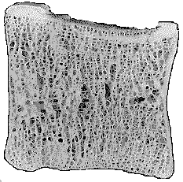
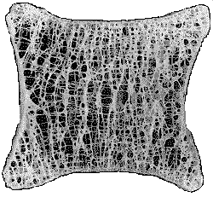
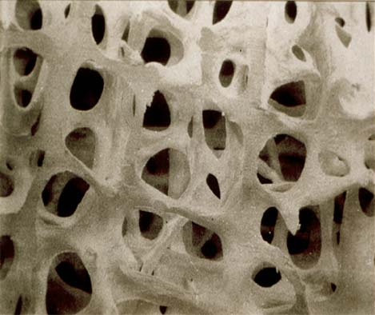
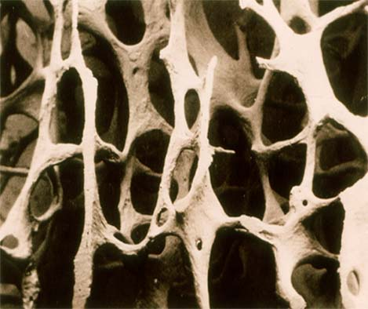
Vertebral body
normal
osteoporotic
MB.ChB V. DR. OTARA

Slide 31
Osteoporosis
Prevalence:
Affects 200 million women worldwide
1/3 of women aged 60 to 70
2/3 of women aged 80 or over
Approximately 30% of women over the age
of 50 have one or more vertebral fractures
1. IOF,2005
2.Dennison E & Cooper C, Horm Res, 2000
MB.ChB V. DR. OTARA

Slide 32
Osteoporosis
Spine ….(46%)
Hip….. (19%)
and
Wrist ….(15%)
fractures are the most common
15 %
19 %
19 %
46 %
MB.ChB V. DR. OTARA

Slide 33
Clinical Risk factors for Osteoporosis
Indications for BMD assessment
Prolonged amenorrhoea
Primary hypogonadism
Other diseases with osteoporosis
Maternal history of hip fracture
Low BMI <19kg/m2
Radiographic osteopaenia
Vertebral deformity
Previous fragility fracture
Prolonged corticosteroids
Premature menopause
Royal College of Physicians Guidelines, London, RCP 1999
MB.ChB V. DR. OTARA

Slide 34
Identify the “high risk” for fracture prevention?
Diagnose those with Osteoporosis
Identify those with high 10 year fracture risk
* T-score=the no. of SDs from the mean value of BMD at peak bone mass
* Osteoporosis involves women with BMD>2.5SD below the young normal mean ( T- score)
Bone mass changes with age
3
2
Normal (above -1)
1
0
Standard Deviations
-1
Osteopaenia b/w -1&-2.5
-2
-3
Osteoporosis <-2.5
-4
0
20
40
60
80
MB.ChB V. DR. OTARA
Age

Slide 35
Methods to measure BMD
The gold standard is Dual Energy X-ray Absorptiometry ( DEXA ) measuring the lower spine, hip & wrist.
Heel measurement is performed as a screening method.
MB.ChB V. DR. OTARA

Slide 36
Treatments of osteoporosis
Calcium and vitamin D
HRT
SERMs (raloxifene)
Calcitonin
Bisphosphonates
  ibandronate
  etidronate
  alendronate
  risedronate
PTH (1–34)
Fluoride
Strontium ranelate
Combination
Hormonal agents
Anti-resorptive agents
Anabolic agents
Dual mechanism of action
SERMs = selective oestrogen receptor modulators
PTH = parathyroid hormone
MB.ChB V. DR. OTARA
Notes:
Treatment and prevention (8)
For those patients at particularly high risk of osteoporosis, or who have developed osteoporosis, there are a number of pharmacological interventions available for the prevention and management of osteoporosis. The aim of these interventions should be to reduce the frequency of fractures, which are responsible for the high levels of morbidity associated with the disease.

